Slide 1
Security Program Implementation
By: Zachary Hopping

Slide 2
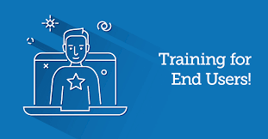
User-Training
User training is very critical our end-users will be the ones targeted in attacks. They need to know how to spot these threats and what they should do if they encounter them.
End-users are vulnerabilities and can be exploited, the more they know and are aware the better equip they will be to secure themselves and our company.
“91% of successful data breaches start with phishing attacks”(Knowbe4)

Slide 3
User-Training Implementation
There are many ways that we can teach our users to be safe, we can set up classroom setting and lecture, do engaging exercise or even tabletop exercises .
The how is not as important as what is taught in the training:
Never give authentication details such as passwords, pins, and smart cards
Always screen emails and keep logs of events
Use encryption protocols whenever transferring data to ensure no evesdroppers.
Never use unknown removable media devices
Be careful when browsing the web to ensure you don't click on suspicious links (this should already be block if our company has implemented our network defense properly)
There is much more that users should be aware of and properly trained to ensure our company is safe from end-users this is just a baseline start.

Slide 4
Physical Security
Physical security is the first line of defense when it comes to securing our company.
Some options we have is putting up fencing around the building and adding CCTV cameras, these are known as deterrence methods.
We can also implement a mantrap with a security guard or a badge scanner this allows us to filter who comes in and who comes out.
This is can become very expensive with a security guard so a cheaper but also secure way would to use a card reader

Slide 5
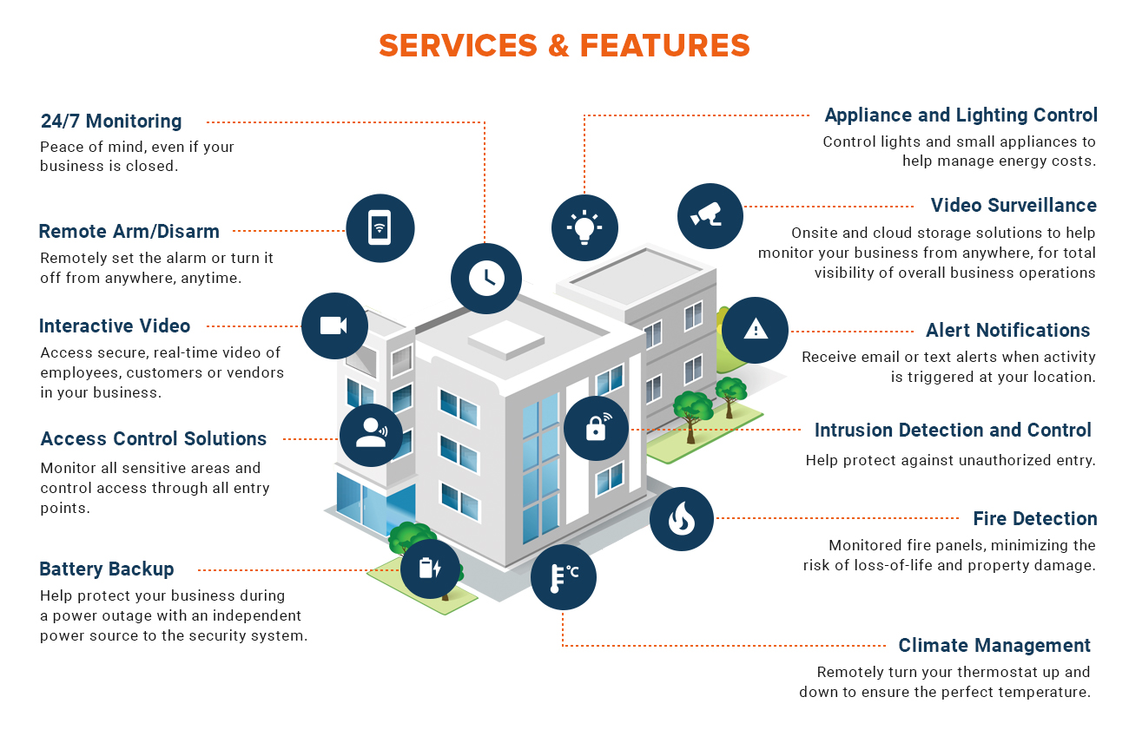

Slide 6
Risk Management
We need to identify assets, prioritize risk, and mitigate and monitor.
There are 4 types of risk management:
Risk Transference: This is like insurance the company still has to face the risk of a server failure, stolen data, or disaster but transfers the risk of losing money on those servers if they were lost.
Risk Avoidance: This is where we would decide to complete eliminate certain hazards that negatively affect our assets.
Risk Reduction: We can install anti-virus software/firewall that will be deterrents that can be put in place.
Risk Acceptance: We will also have to be prepared for accepting risk, some might be too expensive to reduce and will have to accept a certain amount of risk. This will be up to Senior management on what is acceptable
Residual Risk: After all of the previous techniques have been implemented there will still be risk and this is known as residual risk. This will also be up to senior management to decide how much residual risk will be acceptable.

Slide 7
Security Access Control
Attribute-Based access control (ABAC)- is a logical access control model that controls access to objects by evaluating rules against the attributes of the objects actions and environment relevant to a request
Attribute-Based Access Control is much more time intensive and will take more time to set up, after you create policy for each management manually, for every new user you can just copy them to the new users while also modifying it to fit the need of the employee
ABAC allows for a more flexible access control compared to Role based or any other access control policies

Slide 8
Wise Access Control Practices we should implement
Least Privileges: Users should only be granted access to resources and memory that they need to complete their job effectively.
Separation Of Duties: No person should have total oversee of a certain job there should be different people for different parts( an easy way to implement this would be vlans which is discussed later).
Job Rotation: Relates to the previous statement but users should be cycled through different jobs to increase operation security and enhance employee skills.

Slide 9
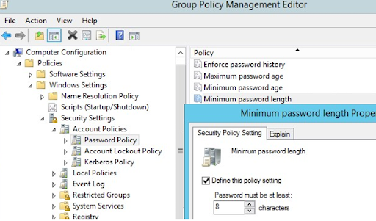
Password Policies
Important password policies should be implemented to ensure that users have strong passwords that won't be reused.
Password History - passwords cannot be reused they must be different each password change
Maximum & Minimum password age - time before password must be changed (6 months)
Password Length - password must meet certain character length
Password Complexity - password must contain upper, lower case, special characters, and numbers

Slide 10
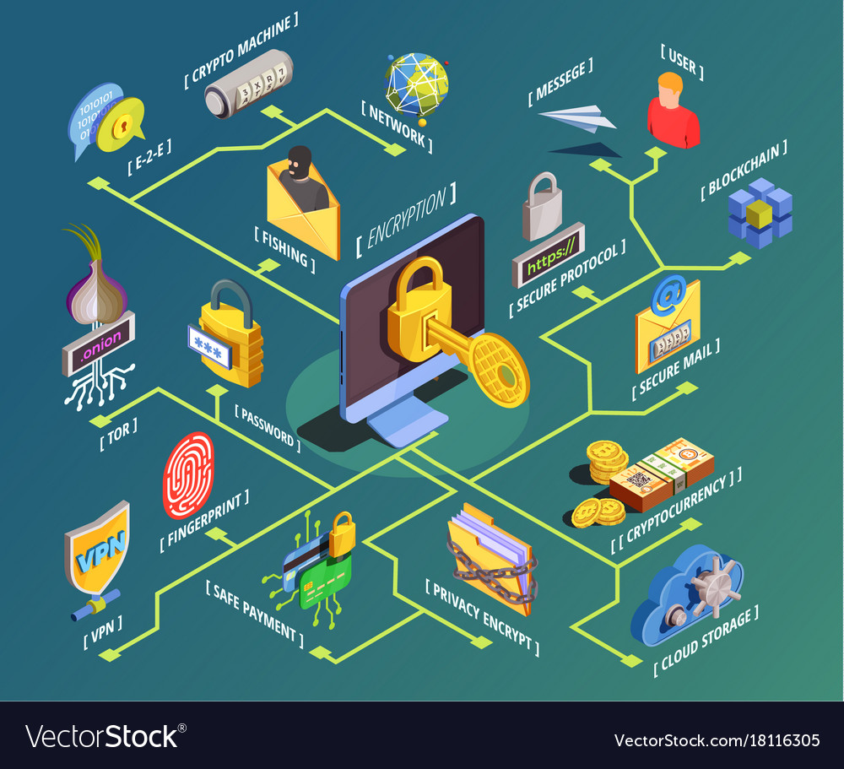
Network Defense
A firewall is the first line of defense when it comes to protecting your network it decides what traffic is allowed and what is denied for example ICMP request, so implementing a strong firewall is very important.
Whitelisting & Blacklisting (Content Filter)- Will block certain websites which will provide protection from employees visiting malicious websites.

Slide 11
Network Defense
Adding IPS/IDS (NIDS/NIPS/HIPS/HIDS)- An IDS will detect an attack and will notify the network administrator. An IPS will, however, notify the admin of an intrusion but the software will also try to prevent the malware or attack from spreading into your system. Implementing an intrusion detection system requires some time and effort you must decide whether you want a “host-based, which is deployed on a single host system and monitors packets or processes on that system. Or a network-based system that uses network cards and sets them to promiscuous mode to analyze data on the network which allows you to monitor multiple systems

Slide 12
Cryptography & Encryption
Symmetric Key Algorithms- Uses single key to decrypt and encrypt data (DES, 3DES, RC, and AES)
Stream Cipher- encrypts each binary digit one at a time
Block Cipher - encrypts a group of bits known as blocks
Asymmetric Key Algorithms- Uses a pair of different keys to encrypt and decrypt data (RSA, Diffie-Hellman, and Elliptic Curve)
Symmetric Key encryption is much faster than asymmetric but is less complex compared to asymmetric encryption.

Slide 13
Incident Response
Having proper procedures in place to respond to incidents or disasters is very important.
Preparation- Having a proper plan of action is very important if not we will be left wide open for attacks and be unable to stop them.
Detection and Analysis- Pinpoint the incident and analysing what is does and how it works, making sure that we have properly documented the whole thing for later review
Containment and Eradication- Once we have found the incident containing it so it does not spread to assets. This will also help with damages and the severity of the incident
Post-incident recovery- FInally the review stage what could we have done differently to stop this attack from happening, how did this attack happen, what could be done in the future to prevent these incidents

Slide 14
Disaster Recovery Plan (DRPs)
Depending on our environment for our company and the location we choose fire, flood, power-loss, and theft can all be disasters we must plan for.
Contact Information- Having the proper information of who to contact if disaster occurs
Impact Determination- Determine disasters full impact this includes assets and cost to replace assets
Recovery Plan- This phase will vary greatly depending on disasters and the determination of disaster impact, it will include estimated time and might also include after action report
Copies of Agreement- copies of agreement with ISP, building management and so on should be stored with DR plan
Disaster Recovery Drills & Exercises- Employees should be trained and prepared for disaster and have steps in place to follow.
Critical Data and Systems- This should be a list of mission critical information and systems necessary for business operations, implementing a backup site to continue work until operations have returned to 100%

Slide 15
References
03. (III) ethical issues. (n.d.). Home. https://www.niatec.iri.isu.edu/ViewPage.aspx?id=153&rebuild=true
Baldrige cybersecurity initiative. (2019, November 15). NIST.
https://www.nist.gov/baldrige/products-services/baldrige-cybersecurity-initiative
Information security policy templates. (n.d.). Information Security Training | SANS Cyber Security
Certifications & Research. https://www.sans.org/security-resources/policies/
Legal ethical and professional issues in information security. (n.d.). Academia.edu - Share research.
https://www.academia.edu/22784580/Legal_Ethical_and_Professional_Issues_in_Information_Security

Slide 16
References
https://nvlpubs.nist.gov/nistpubs/SpecialPublications/NIST.SP.800-82r2.pdf
https://www.ok.gov/cio/documents/InfoSecPPG.pdf
https://www.cengage.com/resource_uploads/downloads/1111138214_259148.pdf

