Slide 1
NIST SP 800-115
By: Zachary Hopping

Slide 2
Introduction
What is NIST SP800-115?
Key factors in a security test
Directs organizations
Why should our company follow NIST SP800-115
Follows guidelines across the industry
Will test your security

Slide 3
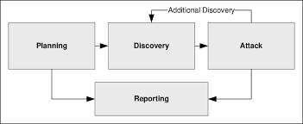
Purpose
The purpose of NIST SP800-115 is an industry-accepted security testing framework. It will test your security for vulnerabilities, document and log vulnerabilities and remediate them to better protect your network from cyber threats.
Examination vs Testing?

Slide 4
Proposed Solution based on SP800-115
The goal of SP800-115 is to overall increase the security posture of that company. At the end of the test whether that is just examination or hands-on testing there is a report that covers the entire test that they did how they did it and how that company can improve to protect themselves from an actual threat actor to do the same thing. They will provide mitigation techniques and propose solutions based on findings

Slide 5
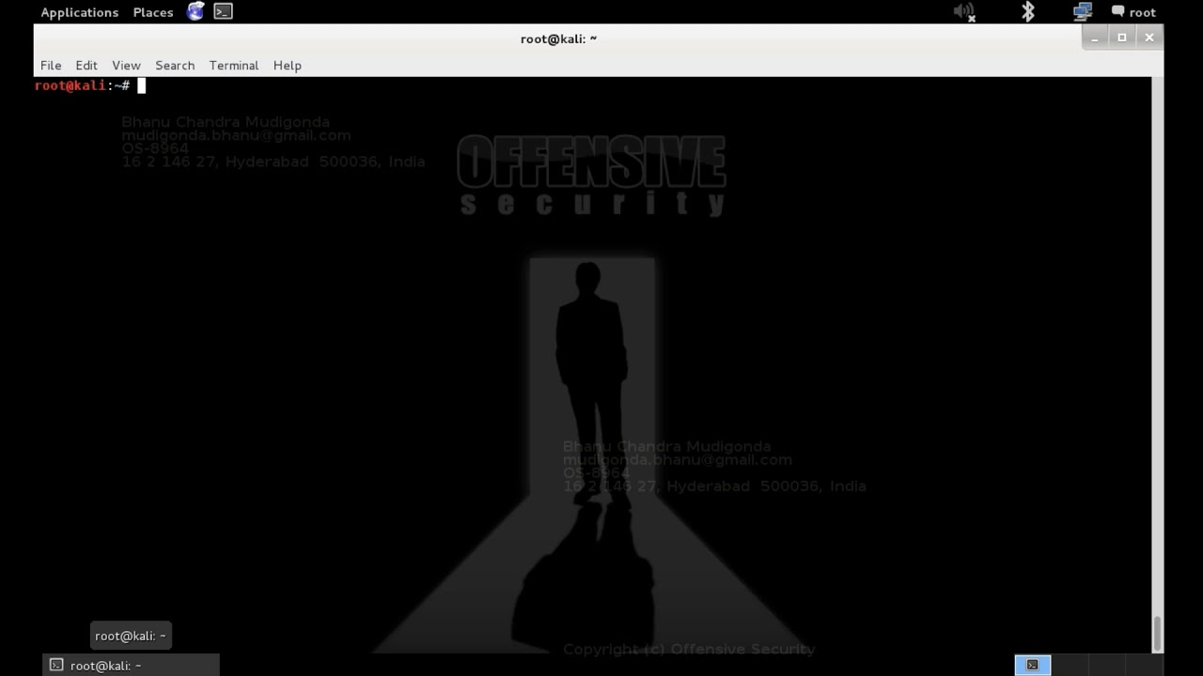
Requisitioned equipment and/or personnel
The required personnel and equipment will vary depending on the test either examination or testing and the scope of the test.
Examination- This usually requires less equipment less qualified users.
Systems for documentation review
Systems designated for vulnerability scanners
Testing- Requirements for testing vary greatly. Users often require greater skills and knowledge of systems
Processing power and memory
Security tools (open source or GOTS)
Dedicated systems
Virtual Machines

Slide 6
Tentative Implementation Timeline
Implementation varies depending on a few factors:
The size of what is being assessed (scope)
The complexity
The feasibility of the test or examination
Level of human interaction required

Slide 7
Budget
Depends widely on what is being tested on how large the network is. The complexity of a lot of variables from the last slide. During my research, I couldn't find any specific numbers but that's because it varies a lot on many factors
Scope
Length of engagement
Tools
Experience of tester
Approach (manual or automated)

Slide 8
Evaluation System
Reporting is the most important part of a test whether it is just an examination or testing of systems/networks
Mitigation Recommendations- Technical and Nontechnical
Reporting:
A reference point for corrective action
Defining mitigation activities
Benchmark
Conduct cost/benefit analysis
Enhance life cycles (risk assessment, software development)

Slide 9
Benefits
As stated before SP 800-115 is in compliance with security guidelines and used by many security professionals. It is designed to implement and maintain technical information relating to security testing and assessment processes and procedures.
SP800-115 will overall increase the security posture of companies the follow the guidelines of SP800-115

Slide 10
Conclusion
Penetration tester gravitates towards NIST SP 800-115 because it gives clear guidance for seeking out vulnerabilities and conducting security tests for an organization. It provides necessary explanations for many major components of security testing which is accepted across the industry.

Slide 11
References
Govinfo | U.S. Government Publishing Office. https://www.govinfo.gov/content/pkg/GOVPUB-C13-6e83fc00473d8374baa2a4449a77082b/pdf/GOVPUB-C13-6e83fc00473d8374baa2a4449a77082b.pdf
How NIST SP 800-115 informs information security & pen test practices. (2020, June 29). KirkpatrickPrice Home. https://kirkpatrickprice.com/blog/how-nist-sp-800-115-informs-information-security-practices/
NIST Page. https://nvlpubs.nist.gov/nistpubs/Legacy/SP/nistspecialpublication800-115.pdf

